Slide 1
DigiVFX Final Project
Labelme with extension function Make label more easier
(System)
P10942A05 鄭閔軒

Slide 2
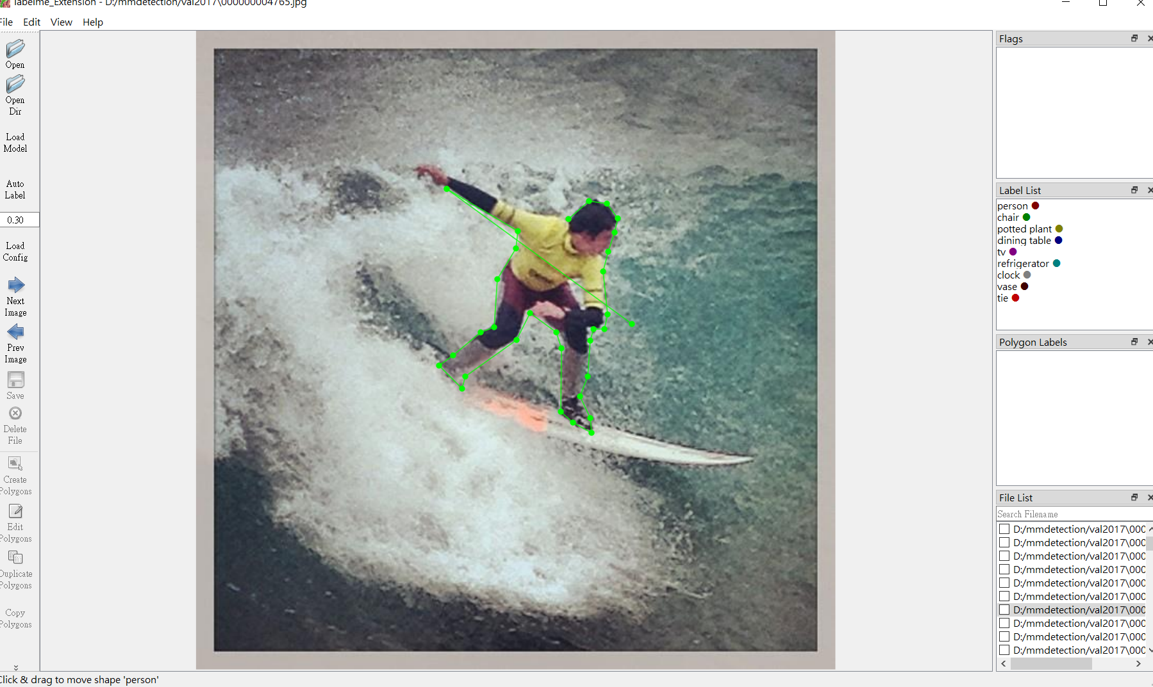
Background
In supervised problem, labeled data is indispensable.
But we should focus in customized our model and its application, not label data.
So we want to make label more easier with existed algorithm.

Slide 3

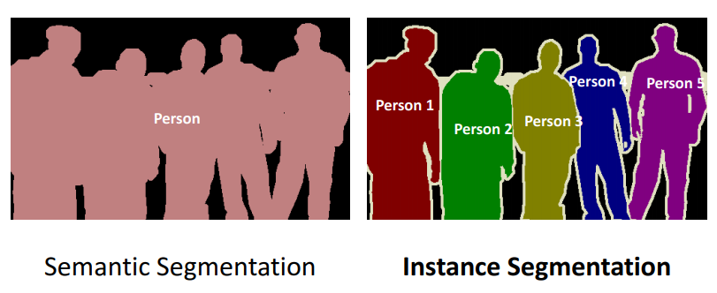
System
Base on “labelme” which is widely used graphical image annotation tool
With extension function on instance segmentation function to help label

